Slide 1
Regression Mediation and Moderation

Slide 2
Mediation
Refers to a situation when the relationship between a predictor variable and outcome variable can be explained by their relationship to a third variable (the mediator).

Slide 3
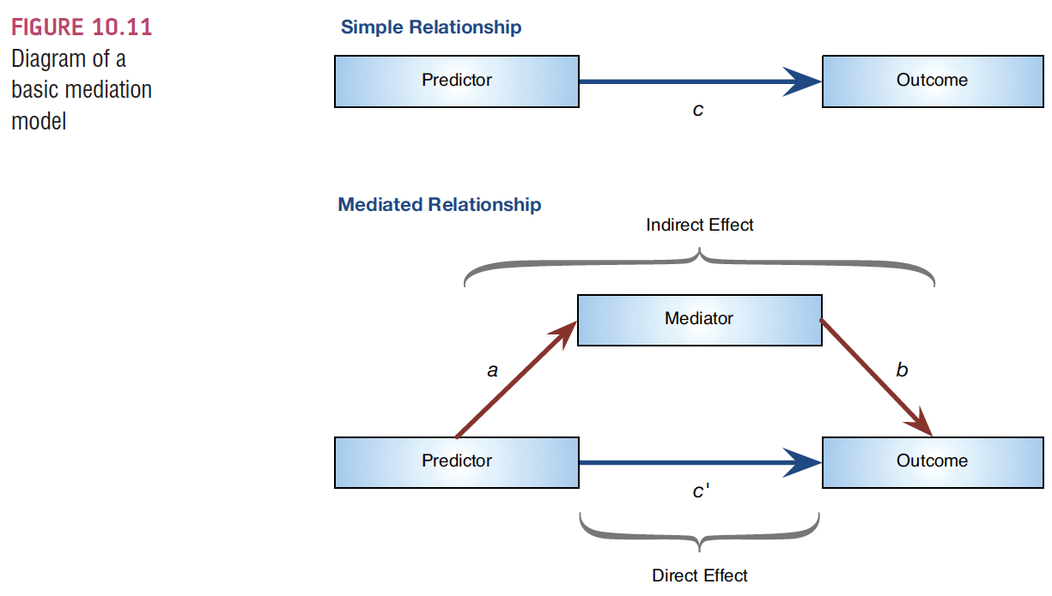
The Statistical Model
Indirect effect = a*b

Slide 4
Baron & Kenny (1986)
Mediation is tested through three regression models:
Predicting the outcome from the predictor variable.
Predicting the mediator from the predictor variable.
Predicting the outcome from both the predictor variable and the mediator.
This procedure has been cited over 35,000 times.

Slide 5
Baron & Kenny (1986)
Four conditions of mediation:
The predictor must significantly predict the outcome variable.
The predictor must significantly predict the mediator.
The mediator must significantly predict the outcome variable.
The predictor variable must predict the outcome variable less strongly in model 3 than in model 1.

Slide 6
Limitations of Baron & Kenny’s (1986) Approach
How much of a reduction in the relationship between the predictor and outcome is necessary to infer mediation?
People tend to look for a change in significance, which can lead to the ‘all or nothing’ thinking that p-values encourage.

Slide 7
Sobel Test (Sobel, 1982)
An alternative is to estimate the indirect effect and its significance using the Sobel test (Sobel, 1982).
If the Sobel test is significant, there is significant mediation
We are going to use the Aroian Test version of Sobel which corrects for the SE of a and b

Slide 8
Bootstrapping
What is bootstrapping?
A procedure where you run an analysis many times to create an average effect and confidence interval of the effect.
Bootstrapped datasets are created by randomly picking a sample from your dataset with replacement
Think about this like the lottery, if they put the balls back.

Slide 9
Bootstrapping
A popular plug in for SPSS is Hayes’ PROCESS.
We will mimic that plug in by doing a bootstrapped mediation in R.
This bootstrapping will allow us to estimate a confidence interval of the indirect (mediation) effect.
If the confidence interval does not cross zero, then that implies a change in the c path.

Slide 10
Mediation
Mediation models usually occur in stages – meaning separate models are run with different IV / DV combinations.
Sometimes called steps but don’t want to confuse that with hierarchical regression models.
So, what does that do for data screening?

Slide 11
Mediation
Data screening:
Screen both the IV and the Mediator at the same time predicting the DV.
This way you are screening the final anticipated stage of the mediation model and are screening all the variables.
You can also use the fake regression procedure to do all three variables at once.

Slide 12
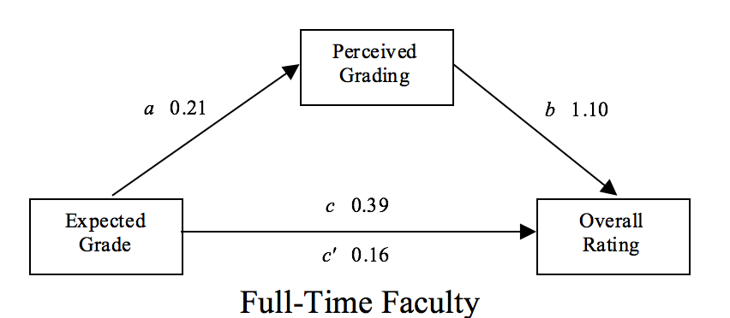
Mediation
How to report:
Tables of the coefficient statistics
Figure

Slide 13
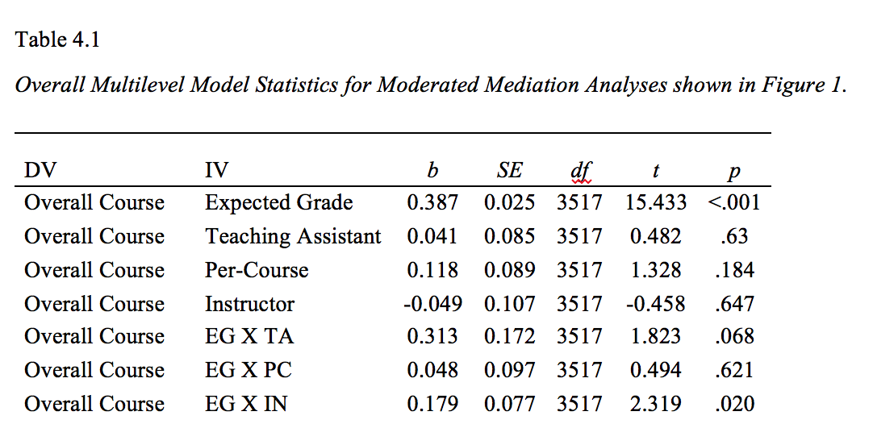
Mediation

Slide 14
Example of a Mediation Model
Does facebook mediate the relationship between previous knowledge and exam scores?
c7.1 mediation.sav

Slide 15
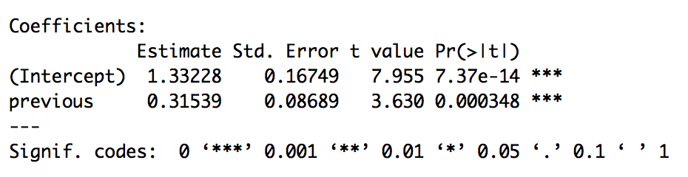
Running in R
First, let’s get the c path: X → Y
model1 = lm(exam ~ previous, data = master)
For the c path, b = 0.32, t(237) = 3.63, p < .001 … we could get pr² here as well.

Slide 16
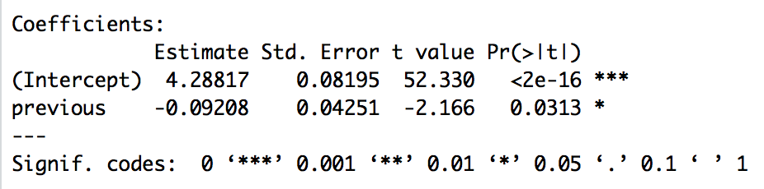
Running in R
Now, the a path: X →M
model2 = lm(facebook ~ previous, data = master)
For the a path, b = -0.09, t(237) = -2.17, p = .031 … we could get pr² here as well.

Slide 17
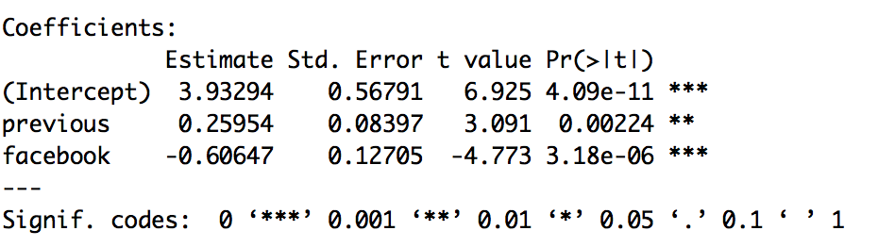
Running in R
Add in the b and c’ paths: X + M → Y
model3 = lm(exam ~ previous + facebook, data = master)
For the b path, b = -0.61, t(237) = -4.77, p < .001 … we could get pr² here as well.

Slide 18
Running in R
Add in the b and c’ paths: X + M → Y
model3 = lm(exam ~ previous + facebook, data = master)
For the c’ path, b = 0.26, t(237) = 3.09, p = .002 … we could get pr² here as well.

Slide 19
Interpretation
Previous experience positively impacts exam scores (c path = 0.32)
Previous experience negatively impacts facebook time (a path = -0.09)

Slide 20
Interpretation
Controlling for previous experience, facebook time negatively impacts exam scores (b path = -0.61)
Controlling for facebok scores, previous experience positively impacts exam scores (c’ path = 0.26)
So, did mediation happen? Is a change from 0.31 to 0.26 important?

Slide 21
Sobel Test
The Aroian Test examines:
Indirect (a*b) / SE of indirect
The SE of the indirect is the product of SE a and b, and cross products of SE and path coefficients.
If the indirect effect is larger than the error, we would conclude that the addition of the M variable changed the c path.

Slide 22
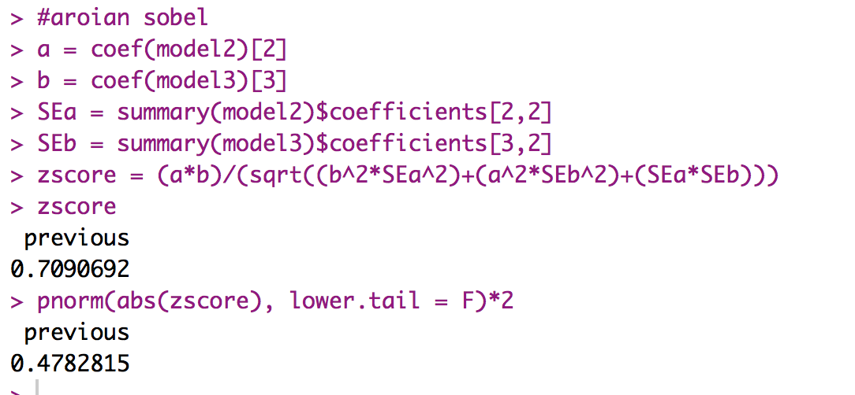
Sobel Test
Fill in the correct coefficient numbers
Note if you use this code provided and fill in X and M in the correct order, you will not need to change the Sobel code.
Z = 0.71, p = .48
We would conclude that no mediation had occurred.

Slide 23
Bootstrapping
We are going to use the boot library.
To make the analysis work, we need to create a function that runs our analysis and pulls out the statistic we are interested in.
This procedure can be any particular statistic: means, SDs, t-tests, etc.

Slide 24
Bootstrapping
indirectsaved = function(formula2, formula3, dataset, random) {
d = dataset[random, ] #randomize by row
model2 = lm(formula2, data = d)
model3 = lm(formula3, data = d)
a = coef(model2)[2]
b = coef(model3)[3]
indirect = a*b
return(indirect)
}
Do not change this one, but just wanted to show what was happening

Slide 25
Bootstrapping
bootresults = boot(data = master,
statistic = indirectsaved,
formula2 = facebook ~ previous,
formula3 = exam ~ previous + facebook,
R = 1000)
We are filling in the dataset and the model 2 and 3 formulas.
Be sure to do X + M.

Slide 26
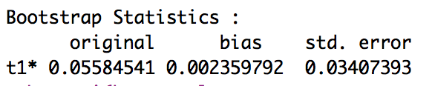
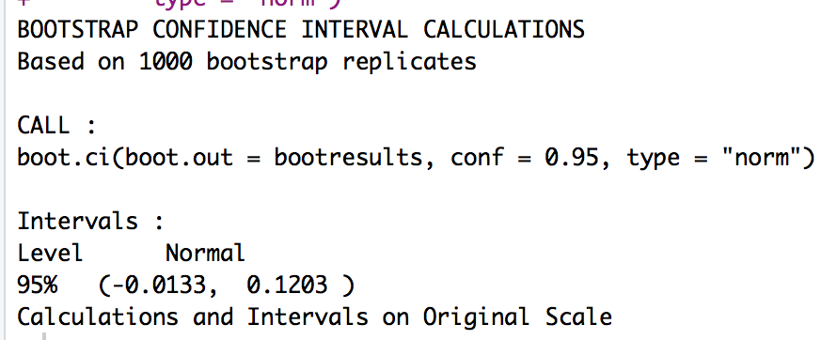
Bootstrapping
Indirect effect = 0.06, bootstrapped 95% CI[-0.01, 0.12]
Note this range includes zero.

Slide 27
Moderation
The combined effect of two variables on another is known conceptually as moderation, and in statistical terms as an interaction effect.

Slide 28
Example
Do violent video games make people antisocial?
DV: Aggression
IV:
Callous unemotional traits (CaUnTs)
Number of hours spent playing video games per week
Interaction

Slide 29
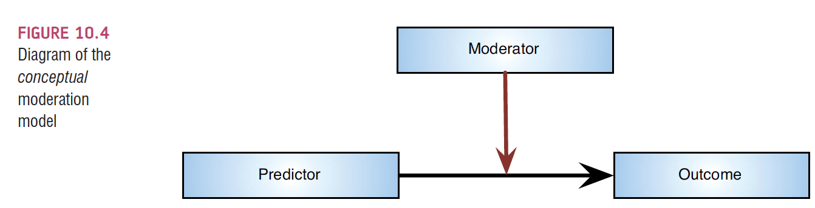
Conceptual moderation model
If callous-unemotional traits were a moderator then we’re saying that the strength or direction of the relationship between game playing and aggression is affected by callous-unemotional traits.

Slide 30
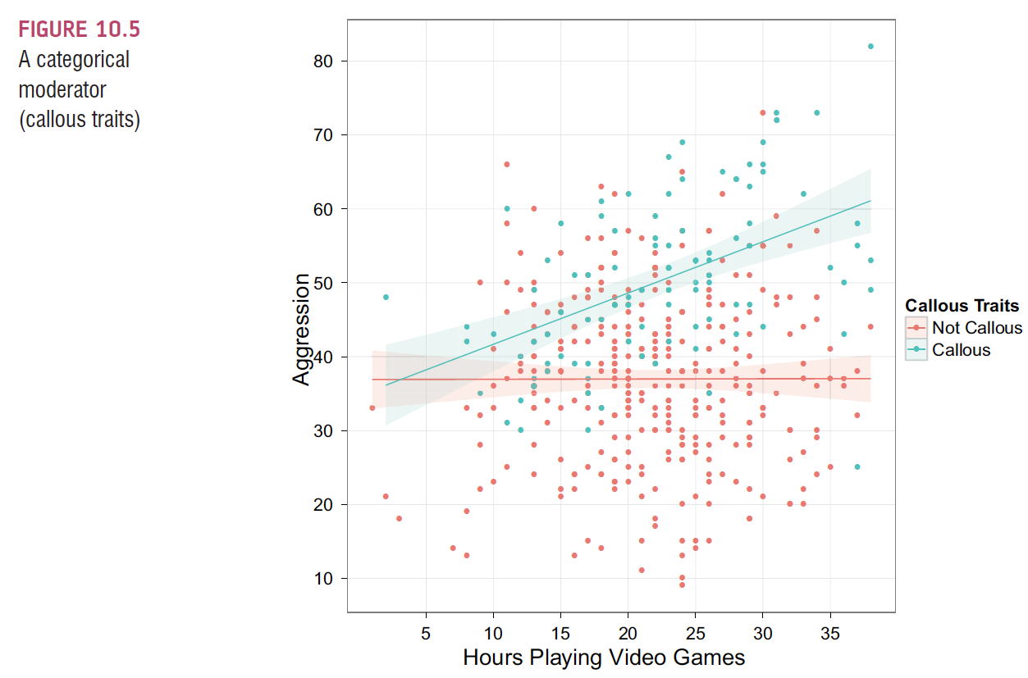
If the X variable was categorical, you are basically checking if the separate groups (levels) have different slopes for the non-categorical variable.

Slide 31
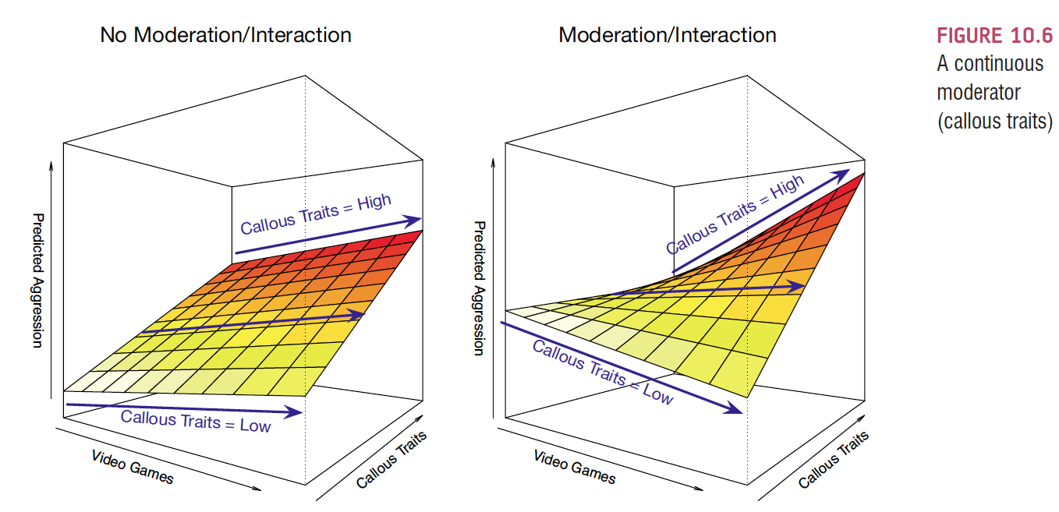
However, if X is continuous, we have to find a new way to figure out the shape of the interaction.

Slide 32
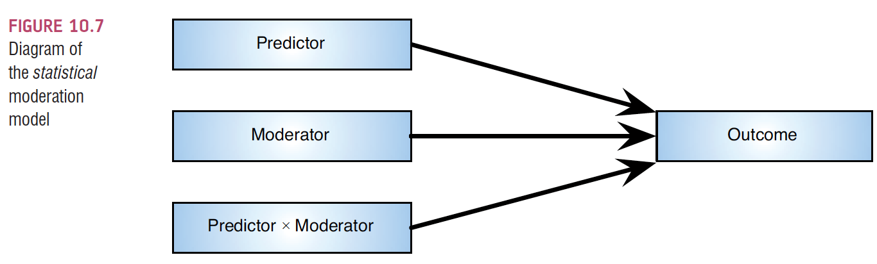
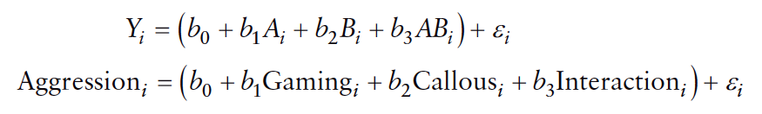
The Statistical Moderation Model

Slide 33
Centering variables
The interaction term makes the bs for the main predictors uninterpretable in many situations.
Centering refers to the process of transforming a variable into deviations around a fixed point.
Centering solves two problems:
Interpretation
Multicollinearity

Slide 34
Centering variables
Easiest way to center to make them useful:
Score – Mean for that variable.
What does that do?

Slide 35
Centering variables
Centered variables for main effects have two interpretations
Effect of that predictor at the mean value for the sample
Average effect of the predictor across a range of scores for the other predictor

Slide 36
Interactions in regression
Just like ANOVA, if the interaction is significant, then you usually ignore the main effects (each variable by itself)

Slide 37
Interactions in regression
So what do I do if my interaction is significant?
Called a simple slopes analysis
(remember before it was called simple effects)
If variables are dichotomous, then you are simply looking at the differences across one variable or another
Much like splitting the variables in post hoc ANOVA

Slide 38
Interactions in regression
For continuous variables, you “create” low, average, and high groups.
Low groups are people who are one SD below the mean
Average groups are people are at the mean
High groups are people who are one SD above the mean
However, creating groups is backwards from what you think.

Slide 39
Example
We are examining the interaction between
Hours of playing video games
Callous – unemotional traits
Predicting
Aggression

Slide 40
Example
Think about which variable you want to know the differences in (i.e. low, average, high)
So at different levels of callousness, we want to examine the relationship between hours of video games and aggression

Slide 41
Running in R
Center your variables using scale()
dataset$zcolumn = scale(dataset$original, scale = F)
Using scale = F turns off dividing by SD, which would create z-scores.
You can use z-score centering if you wanted the coefficients to be beta. It is likely easier to interpret the b values though.

Slide 42
Running in R
Run the model:
modmodel = lm(DV ~ zIV * zIV2, data = dataset)
You do not have to create an interaction column – using the * to multiply does that automatically for you.
Also includes the main effects!

Slide 43
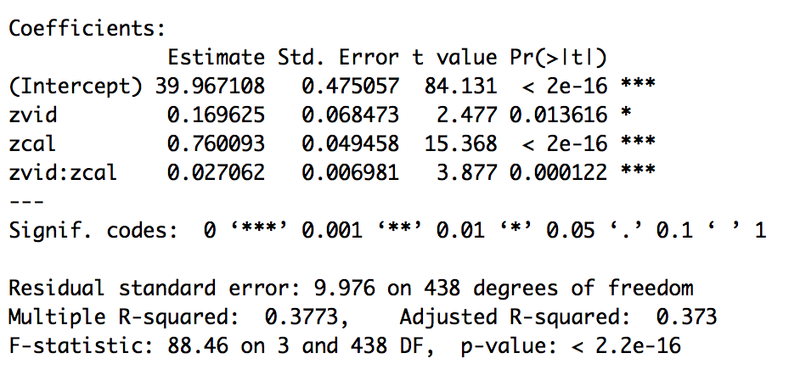
Interpretation
Overall model is significant, F(3, 438) = 88.46, p < .001, R² = .38

Slide 44
Interpretation
Interaction effect is significant, b = 0.03, t(438) = 3.88, p < .001

Slide 45
Simple Slopes
So, how do we create groups when we have a continuous variable?
Most people look at ”low” as one SD below the mean and “high” as one SD above the mean.
Lots of combinations are possible though.

Slide 46
Simple Slopes
Create the low and high versions of the M variable (callousness in this example)
Low created by ADDING a SD
High created by SUBTRACTING a SD
The rule is that we have to bring them to the middle because we centered so that zero is the middle
Periscope example

Slide 47
Simple Slopes
Then run the model with the new low and high versions of the variable.
What do I do with that?
You look at the other variable because the coefficients for M and X*M will not change.

Slide 48
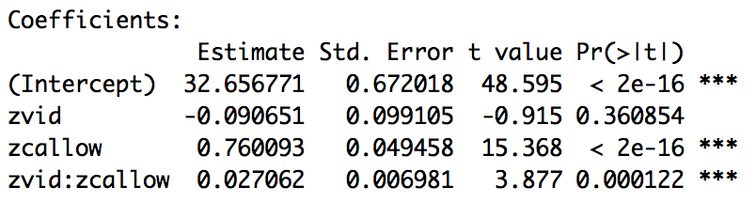
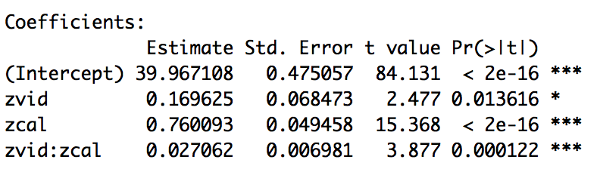
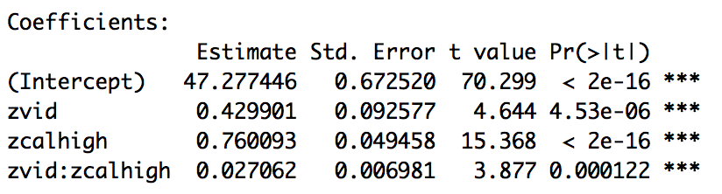
Simple Slopes

Slide 49
Interpretation
At low levels of callousness, video game hours is unrelated to aggression, b = -0.09 …
At average levels of callousness, hours of video games predicts increasing aggression, b = 0.17 …
At high levels of callousness, the strength of hours of video games predicting aggression is the strongest, b = 0.43 ...

Slide 50
Interpretation
Significant interactions will create fan effects of slopes that either get stronger/weaker in strength or switch directions.
Here, we find that increasing levels of callousness leads to increasing effects of video game time on aggression.

Slide 51
Graphs!
We can use the ggplot to create a graph of the moderation effect – but we are going to manually draw the lines on a scatterplot graph.

